Slide 1




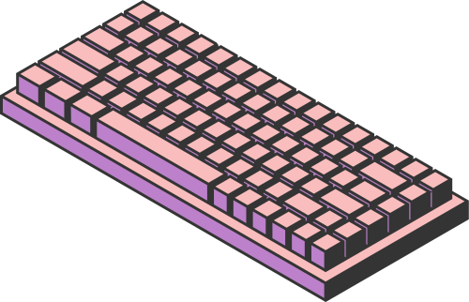
STUDIO SHODWE
HOME
SERVICE
ABOUT US
CONTACT US
COMPUTER
TECHNOLOGY
A project is a series of planned tasks with a clear objective, often involving multiple steps. It can be carried out by individuals or teams and is designed to achieve specific outcomes within a set timeframe.
Page 01

Slide 2

STUDIO SHODWE
HOME
SERVICE
ABOUT US
CONTACT US
INTRODUCTION
A project refers to a sequence of tasks that are carefully planned and executed to achieve a specific objective. Projects are essential in various fields, such as business, engineering, and education, and often require collaboration and resources. Each project has a start and an end, along with defined goals and deliverables. The success of a project is usually determined by how effectively the team meets the objectives within the allocated time and resources.
A project refers to a sequence of tasks that are carefully planned and executed to achieve a specific objective.
Page 02

Slide 3

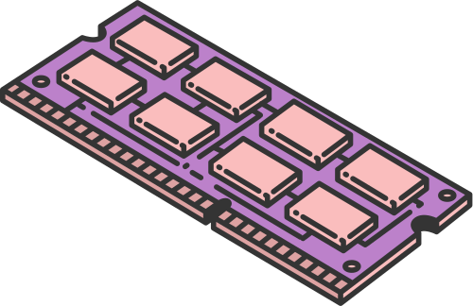
STUDIO SHODWE
HOME
SERVICE
ABOUT US
CONTACT US
HARDWARE
COMPONENTS
CENTRAL PROCESSING UNIT (CPU)
MEMORY (RAM & STORAGE)
A project refers to a sequence of tasks that are carefully planned and executed to achieve a specific objective. Projects are essential in various fields, such as business, engineering, and education, and often require collaboration and resources. Each project has a start and an end, along with defined goals and deliverables.
A project refers to a sequence of tasks that are carefully planned and executed to achieve a specific objective. Projects are essential in various fields, such as business, engineering, and education, and often require collaboration and resources. Each project has a start and an end, along with defined goals and deliverables.
Page 03

Slide 4


STUDIO SHODWE
HOME
SERVICE
ABOUT US
CONTACT US
SOFTWARE
COMPONENTS
A project refers to a sequence of tasks that are carefully planned and executed to achieve a specific objective. Projects are essential in various fields, such as business, engineering, and education, and often require collaboration and resources. Each project has a start and an end, along with defined goals and deliverables. The success of a project is usually determined by how effectively the team meets the objectives within the allocated time and resources.
A project refers to a sequence of tasks that are carefully planned and executed to achieve a specific objective. Projects are essential in various fields, such as business, engineering, and education, and often require collaboration and resources.
Page 04

Slide 5



STUDIO SHODWE
HOME
SERVICE
ABOUT US
CONTACT US
NETWORKING
& THE INTERNET
A project is a series of planned tasks with a clear objective, often involving multiple steps. It can be carried out by individuals or teams and is designed to achieve specific outcomes within a set timeframe.
A project is a series of planned tasks with a clear objective, often involving multiple steps. It can be carried out by individuals or teams and is designed to achieve specific outcomes within a set timeframe.
Page 05

Slide 6



STUDIO SHODWE
HOME
SERVICE
ABOUT US
CONTACT US
DATA
MANAGEMENT
DATABASE
DATA & SECURITY
DATA ANALYTICS
A project is a series of planned tasks with a clear objective, often involving multiple steps. It can be carried out by individuals or teams and is designed to achieve specific outcomes within a set timeframe.
A project is a series of planned tasks with a clear objective, often involving multiple steps. It can be carried out by individuals or teams and is designed to achieve specific outcomes within a set timeframe.
A project is a series of planned tasks with a clear objective, often involving multiple steps. It can be carried out by individuals or teams and is designed to achieve specific outcomes within a set timeframe.
Page 06

Slide 7
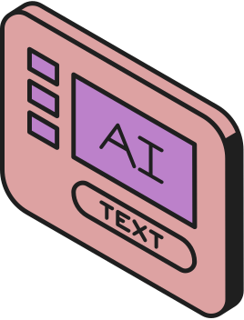

STUDIO SHODWE
HOME
SERVICE
ABOUT US
CONTACT US
ARTIFICIAL
INTELLIGENCE
A project is a series of planned tasks with a clear objective, often involving multiple steps. It can be carried out by individuals or teams and is designed to achieve specific outcomes within a set timeframe.
A project is a series of planned tasks with a clear objective, often involving multiple steps. It can be carried out by individuals or teams and is designed to achieve specific outcomes within a set timeframe.
Page 07

Slide 8

STUDIO SHODWE
HOME
SERVICE
ABOUT US
CONTACT US
CYBER
SECURITY
A project is a series of planned tasks with a clear objective, often involving multiple steps. It can be carried out by individuals or teams and is designed to achieve specific outcomes within a set timeframe.
A project is a series of planned tasks with a clear objective, often involving multiple steps. It can be carried out by individuals or teams and is designed to achieve specific outcomes within a set timeframe.
Page 08

Slide 9



STUDIO SHODWE
HOME
SERVICE
ABOUT US
CONTACT US
FUTURE
IN TECHNOLOGY
A project is a series of planned tasks with a clear objective, often involving multiple steps. It can be carried out by individuals or teams and is designed to achieve specific outcomes within a set timeframe.
A project is a series of planned tasks with a clear objective, often involving multiple steps. It can be carried out by individuals or teams and is designed to achieve specific outcomes within a set timeframe.
Page 09

Slide 10







STUDIO SHODWE
HOME
SERVICE
ABOUT US
CONTACT US
THANK YOU
+123-456-7890
WWW.REALLYGREATSITE.COM
123 ANYWHERE ST., ANY CITY
Page 10

